Slide 1
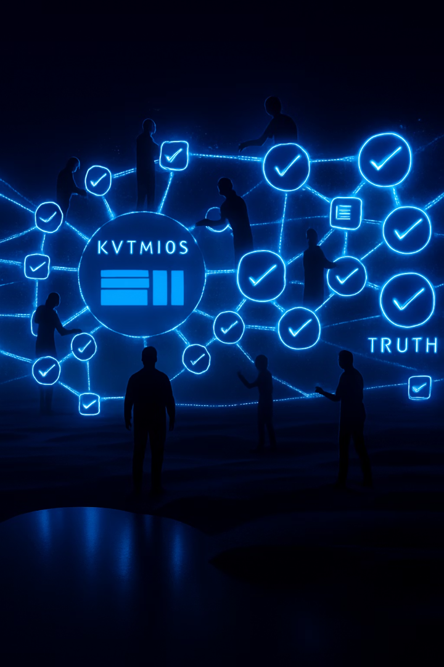



Improved Multi-Agent Knowledge Sharing System for News Bias Detection
Christopher Washer, Modupeola Fagbenro, Pavani Chella
3 Contributors

Slide 2

Introduction
Misinformation and media bias threaten public trust and political discourse.
Social media accelerates the spread of false narratives faster than fact-checkers can respond.
Knowledge Graphs (KGs) structure real-world facts to support reasoning.
Multi-Agent Systems (MAS) enable distributed, specialized analysis tasks.
Our proposed system combines MAS and a dynamic KG to detect bias and verify facts in real-time news evaluation.
Notes:
Misinformation and media bias are major threats to public trust and healthy political discourse. Social media accelerates the spread of false narratives much faster than fact-checkers can respond. Knowledge Graphs provide a structured way to represent real-world facts and support logical reasoning. Multi-Agent Systems enable distributed, specialized analysis tasks to be carried out in parallel. Our proposed system combines these two powerful technologies - a dynamic Knowledge Graph and a Multi-Agent System - to detect bias and verify facts in real-time news evaluation.

Slide 3
Problem Statement
Manual fact-checking cannot match the speed and volume of online content.
Bias detection requires nuanced understanding beyond simple text analysis.
Large Language Models (LLMs) alone struggle with factual grounding and context.
Automated systems enhanced with KGs can provide faster, more reliable news evaluation by grounding AI reasoning in real-world knowledge.

Slide 4
Research Objectives
Primary objectives
1. Assess the impact of shared KG-based memory in a multi-agent system on news bias detection and fact-checking accuracy.
2. Measure the performance difference between multi-agent systems with and without KG integration to show the effect a KG can have in addressing complex news evaluation tasks.

Slide 5
Research Questions
Specific Research Questions
1. What is the impact of knowledge graph integration into multi-agent system capabilities in bias detection, fact-checking, and overall system evaluation?

Slide 6

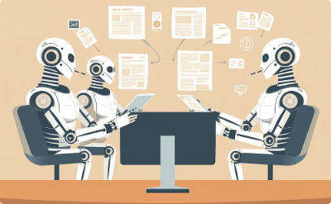
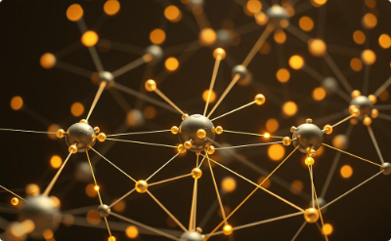

Approach
Fact-Checking
Bias Detection
Knowledge Graph Integration
External Tools Integration
Agents focus on verifying content by performing context evaluation for accurate assessments.
Agents compare new articles to ones available in knowledge to evaluate news.
Agents use the knowledge graph to enhance decision-making.
Leverage NewsAPI to build comprehensive news knowledge graph

Slide 7
System Architecture

Slide 8
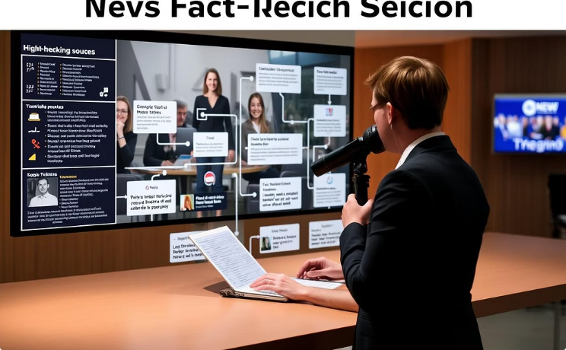
Fact-Checker Agent
Verifies news claims by cross-referencing trusted sources and real-time Knowledge Graph data for factual accuracy.

Slide 9
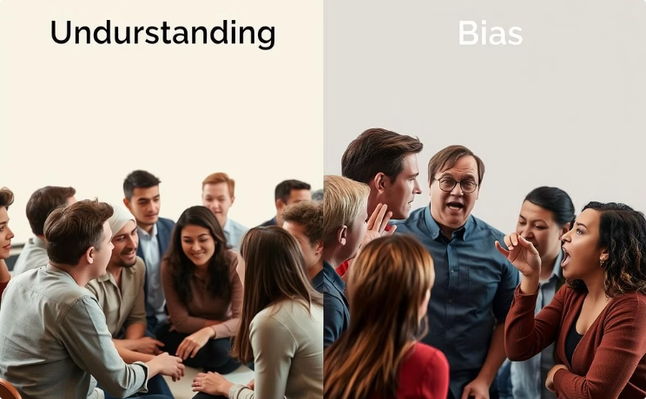
Bias Detection Agent
Detects political bias through language cues and ideological framing using NLP models with Knowledge Graph context.

Slide 10
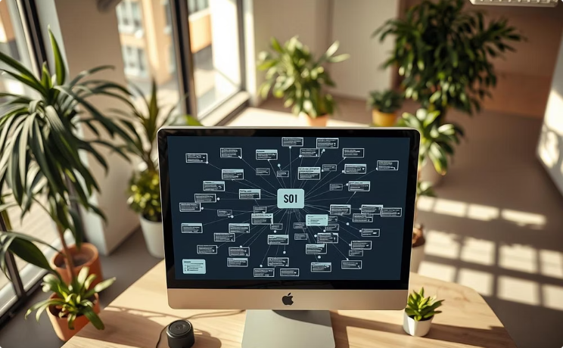
Knowledge Graph
A Neo4j database aggregating facts, insights, and metadata for dynamic sharing and reasoning across agents.

Slide 11

Agent Manager
Coordinates tasks and communication for efficient collaboration among specialized agents in the system.

Slide 12
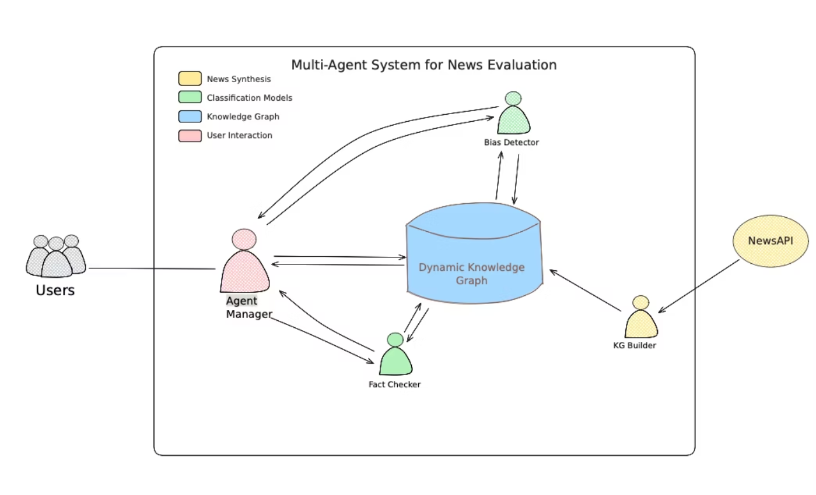

Slide 13



Datasets
News API
AllSides Media
Media Bias Fact Check
Free API to collect news articles for building knowledge graph.
Used to annotate news articles with bias rating based on source.
Daily verified fact checks to build evaluation dataset.

Slide 14
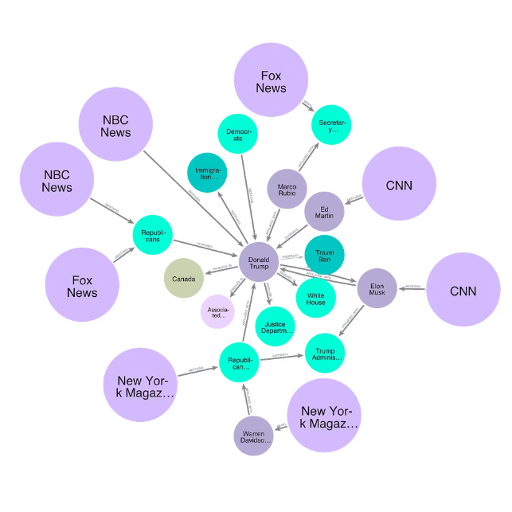
Knowledge Graph
A structured network representing news entities and their interconnections.
Acts as a centralized shared memory accessible by all agents.
Continuously updates with incoming articles and verified facts.
Enables multi-hop reasoning to support fact-checking and bias detection.
Improves accuracy and helps to minimize hallucinations common in large language models.

Slide 15
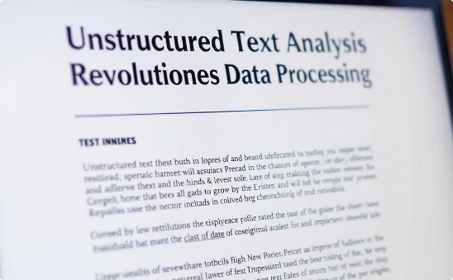
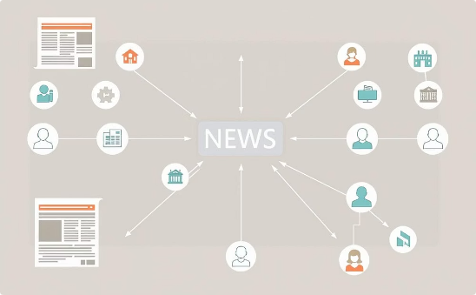
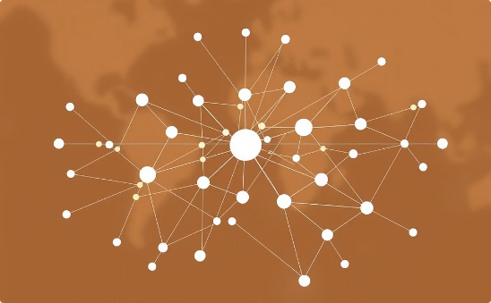
KG Builder Overview
Extract Triplets
Connect to Article
Merge into KG
Extract entities and their relationships from unstructured news articles.
Link each extracted triplet to its respective Article node in the graph.
Integrate new nodes and relationships seamlessly into the existing Knowledge Graph.

Slide 16

Example News Article
"Trump holds firm on tariffs as the White House looks to calm nervous allies."
Extracted Triplets
(Donald Trump) -[SUPPORTS]-> (Global Tariffs)
(Donald Trump) -[INVOLVED_IN]-> (United States)
(Republican Party) -[INVOLVED_IN]-> (Global Tariffs)
(Jamie Dimon) -[AFFILIATED_WITH]-> (Jpmorgan Chase)
(Dave Portnoy) -[AFFILIATED_WITH]-> (Barstool Sports)
(Dave Portnoy) -[SUPPORTS]-> (Donald Trump)

Slide 17
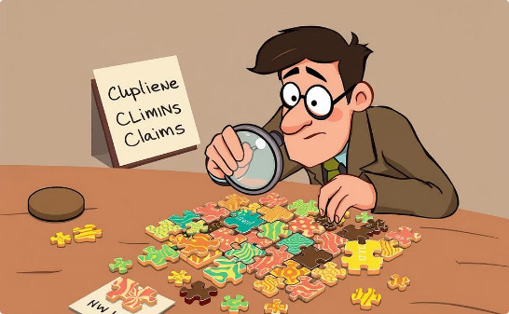
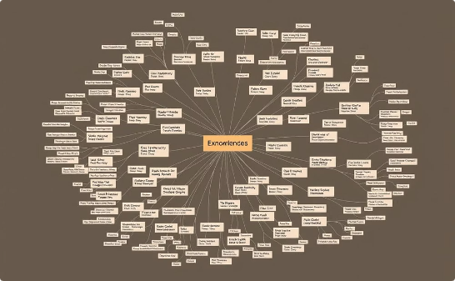

Fact-Checker Agent
Breaking down claims into structured components
Querying the Knowledge Graph for evidence
Generating grounded LLM prompts and delivering verdicts

Slide 18
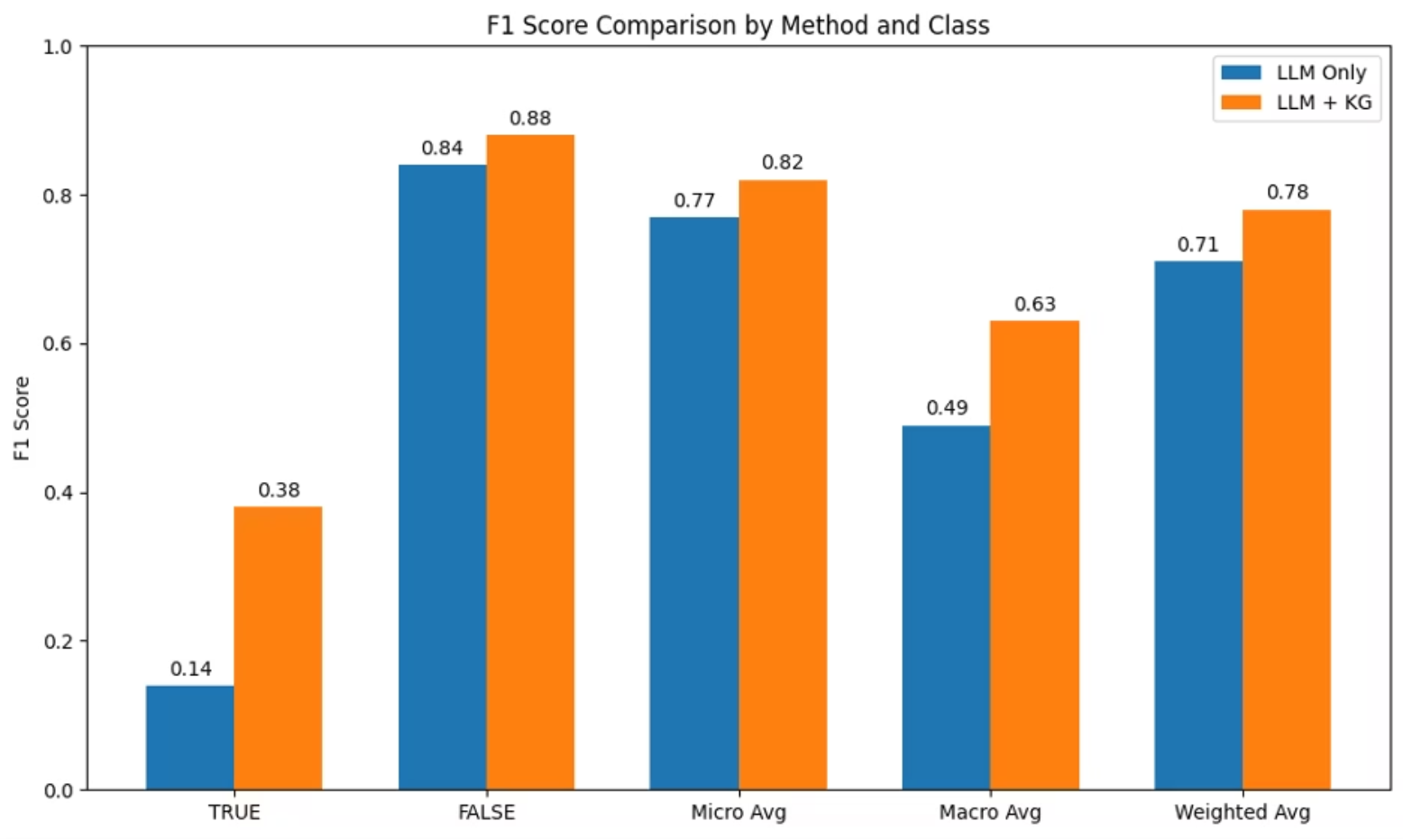

Slide 19
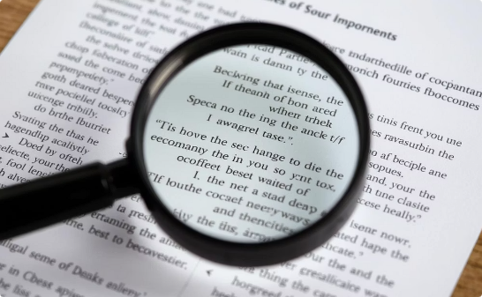
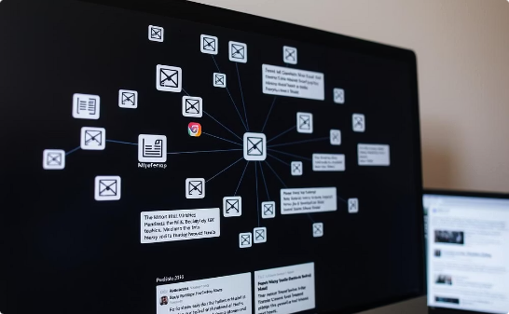
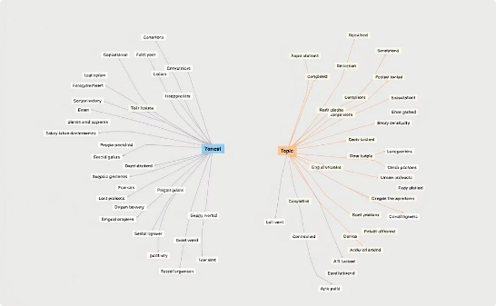
Bias Detection Agent
Article Parsing
Retrieves Similar Articles
Structural Similarity
Extracts key information from articles for detailed analysis
Uses the Knowledge Graph to find related articles for comparison
Enhances bias classification accuracy by examining article structures

Slide 20
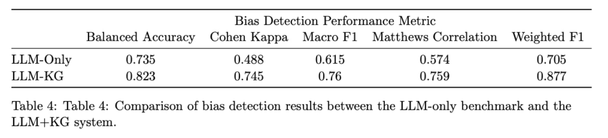
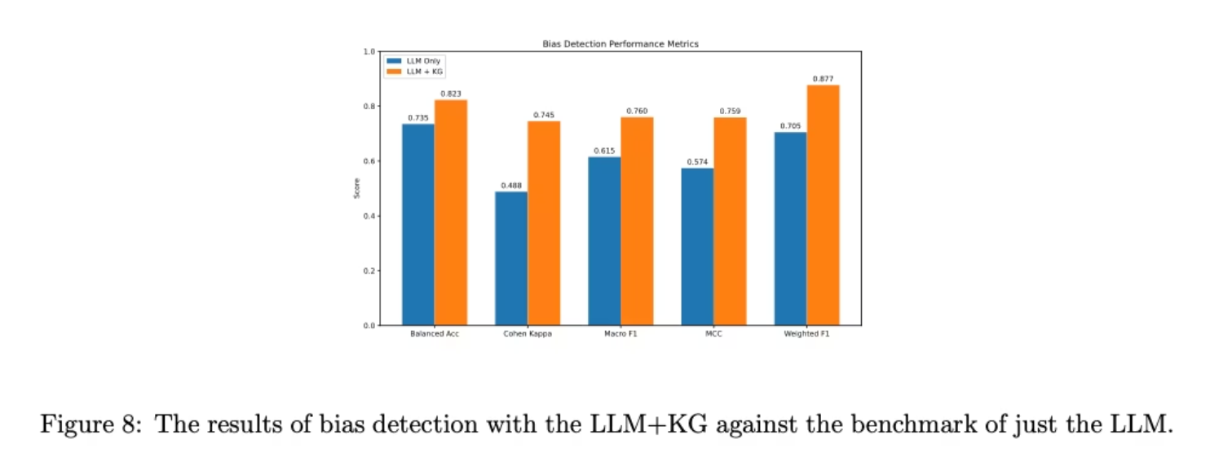

Slide 21
Experimental Results
Fact-Checking Improvements
Bias Detection Gains
True claims recall: +257%
Balanced Accuracy: 0.735 → 0.823
Macro F1: 0.49 → 0.63
Cohen's Kappa: +53%
Micro F1: 0.77 → 0.82
Macro F1: 0.615 → 0.76

Slide 22
Conclusion
Summary of Key Contributions
Developed a multi-agent system combining LLMs and Knowledge Graphs.
Achieved significant improvements in bias detection and fact-checking accuracy.
Research Objectives and Results
Validated that KG integration improves LLM system performance.
Demonstrated measurable gains across key evaluation metrics.
Real-World Applications
Real-world deployment in journalism for rapid bias and fact-checking.
Supports media literacy education and critical news analysis.

Slide 23


Future Work
Architectural Enhancements: Improve agent communication; allow agents to update the Knowledge Graph dynamically.
2
Knowledge Graph Upgrades: Add vector embeddings (GraphRAG) and time-sensitive weighting.
3
New Agent Types: Introduce rhetorical analysis, credibility checking, and narrative framing agents.
4
Deployment Considerations: Focus on scalability, robust error handling, user-specific interfaces, and ethical guidelines.

